Slide 1
Climate Effects on Bee Biodiversity in California
Mario Acevedo, Kapewa Hopfe, Isaak Lugo, Ashley Meinke, Mandy Roberts, and Denzill Loe

Slide 2
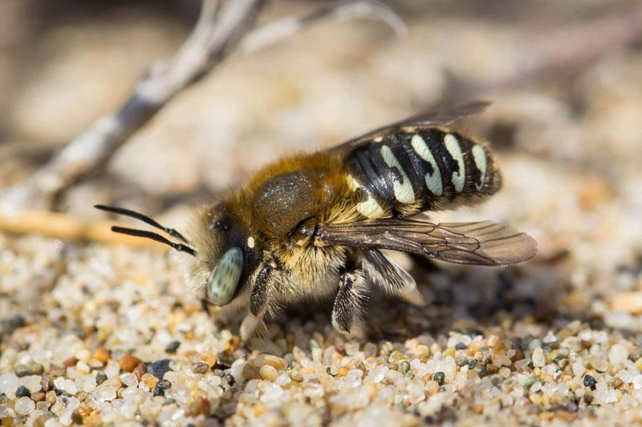
Climate and Bees
Temperatures to rise 1-7 ᐤC
Drier seasonal conditions
1600 bee species in California
Notes:
Photo credit: https://www.hummingbirdsplus.org/nature-blog-network/the-diverse-community-of-native-bees-in-california/
Citation: https://climateresilience.ca.gov/overview/impacts.html

Slide 3
Why Conserve Bees?
Pollination
Economic Value
Agriculture
Global Impact
75% of flowering plant pollination is done by bees
$15 billion crop value annually
One out of every four bites
80% of flowering plants worldwide

Slide 4
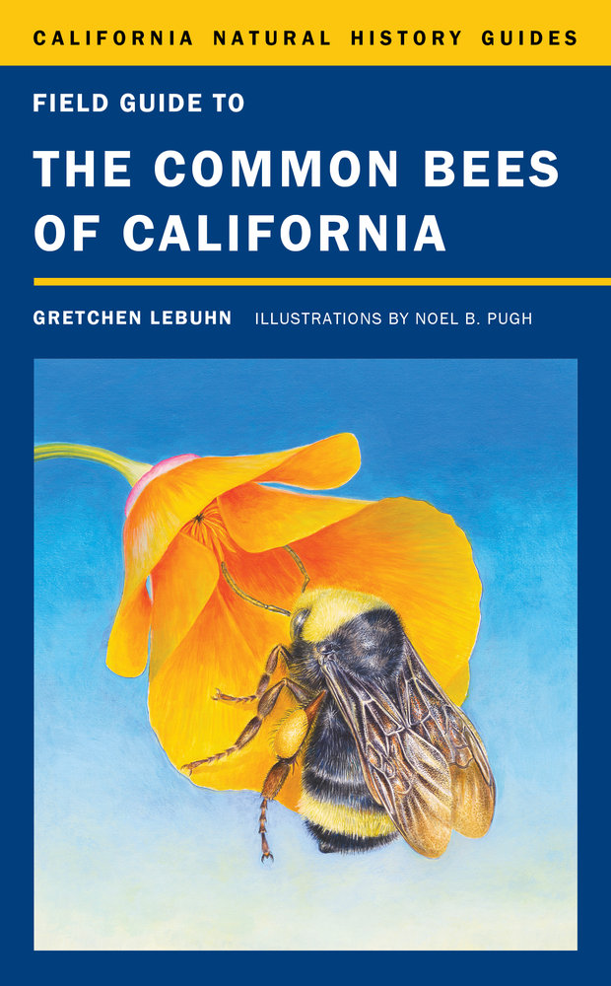
Bee Diversity and Endemism
Species richness = number of species
Endemism = # unique to region species
Vulnerable to extinction
Adapted to specific habitat
More endemic species means more biodiversity

Slide 5
Research Questions
01
02
Where are the centers of diversity for bees?
Species Richness
Endemism
Hypothesis: Centers of diversity will be in regions with low levels of rainfall
Species Richness
Endemism

Slide 6

Methods
Utilized a dataset from Dr. Gretchen LeBuhn and graduate student Gilbert Alarcon-Cruz
Downloaded precipitation data and estimated average precipitation for each grid cell using ArcGIS
Created a linear model to identify any relationships

Slide 7
Research Questions
01
02
Where are the centers of diversity for bees?
Species Richness
Endemism
Hypothesis: Centers of diversity will be in regions with low levels of rainfall
Species Richness
Endemism

Slide 8
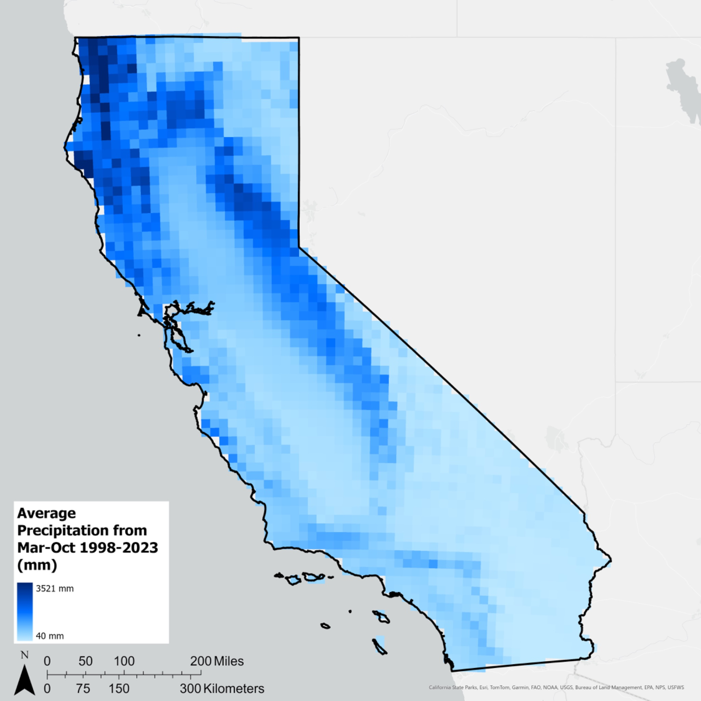
Average Winter Precipitation Over 25 years
Notes:
Working with the climate data we downloaded, here is a map of average rainfall across California compiled from 25 years of spring precipitation data
Each cell represents a 15 km2 area that contains the amount of average rainfall recorded within this region, where darker shades of blue mean higher rainfall amounts and lighter shades mean lower.
From 1988 to 2023, average precipitation in California ranged from a minimum of 40 mm to 3521 mm
We can see that higher rainfall is concentrated to the northwestern regions of the state as well as the Sierra Nevada Range

Slide 9
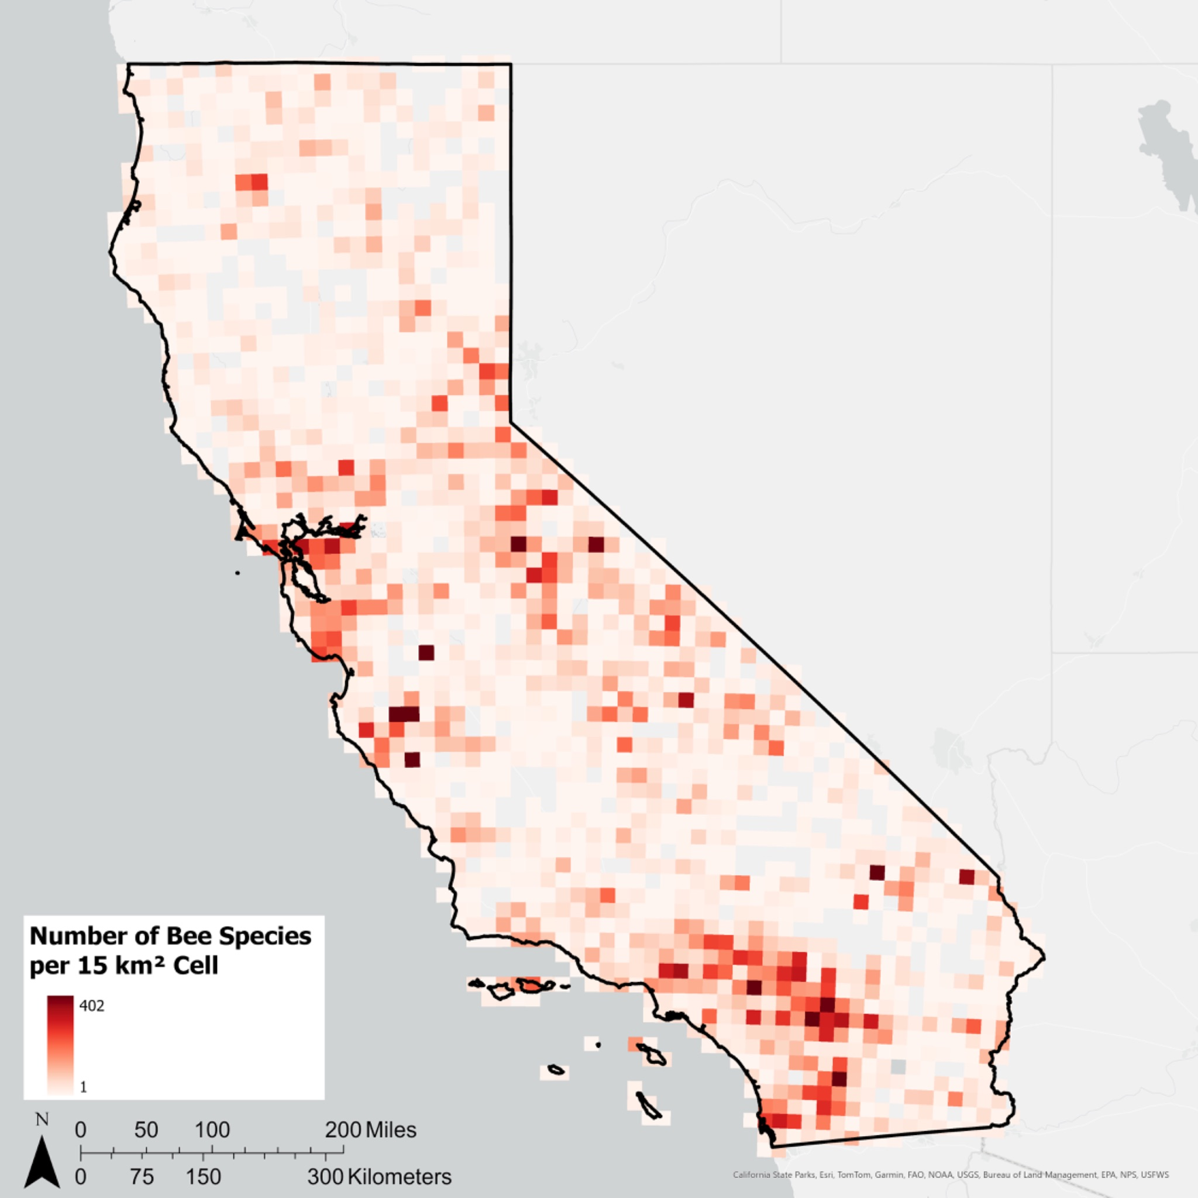
Bee Species Richness Across California
Notes:
Using that climate variable, we wanted to compare it to the bee data that we have
So here we have a spatial distribution in species richness of bees in California
In the same cell size as the precipitation map, this map shows the number of unique bee species recorded in each box and in California they range from 1 species per box up to 402
We have concentrations of higher species richness in areas such as the Bay Area, the Sierra Nevada Range again, and in the greater Los Angeles region.

Slide 10
Average Winter Precipitation Over 25 Years
Bee Species Richness Across California
Notes:
Using that climate variable, we wanted to compare it to the bee data that we have
So here we have a spatial distribution in species richness of bees in California
In the same cell size as the precipitation map, this map shows the number of unique bee species recorded in each box and in California they range from 1 species per box up to 402
We have concentrations of higher species richness in areas such as the Bay Area, the Sierra Nevada Range again, and in the greater Los Angeles region.

Slide 11
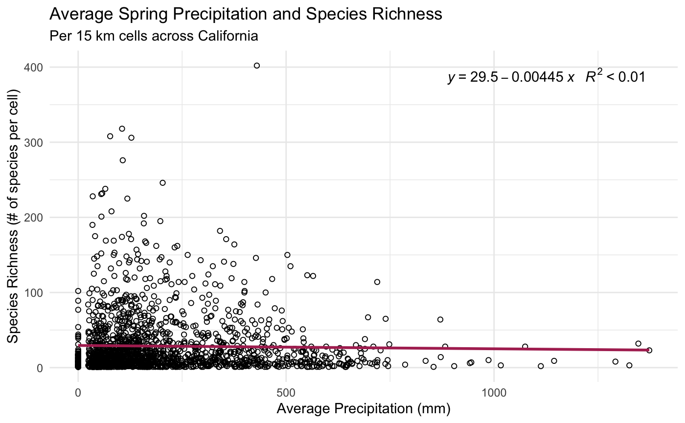
You can replace the image on the screen with your own work. Just delete this one and add yours

Slide 12
Code for Species Richness and
Precipitation Graph
ggplot(data = beeData, aes(x = PPT, y = X_RICHNESS_ALL_)) +
geom_point(color = "black", pch = 21) +
geom_smooth(method = "lm", se = FALSE, color = "maroon") +
labs (
title = "Average Winter Precipitation and Species Richness",
subtitle = "Per 15 km cells across California") +
xlab("Average Precipitation (mm)") +
ylab("Species Richness (# of species per cell)") +
theme_minimal() +
stat_poly_eq(aes(label = paste(..eq.label.., ..rr.label.., sep = "~~~")),
label.x = "right", label.y = "top", formula = y ~ x, parse = TRUE)
Notes:
Drier Areas are more important for bees and endemic species in California
Protection
Pay attention to the dry areas
Climate change and shifts in climate extremes may help with shift of bee distribution to increasingly arid areas
Extended periods of drought may put populations at risk
Range shifts
Management of lands reflect supporting bee populations

Slide 13
Research Questions
01
02
Where are the centers of diversity for bees?
Species Richness
Endemism
Hypothesis: Centers of diversity will be in regions with low levels of rainfall
Species Richness
Endemism

Slide 14
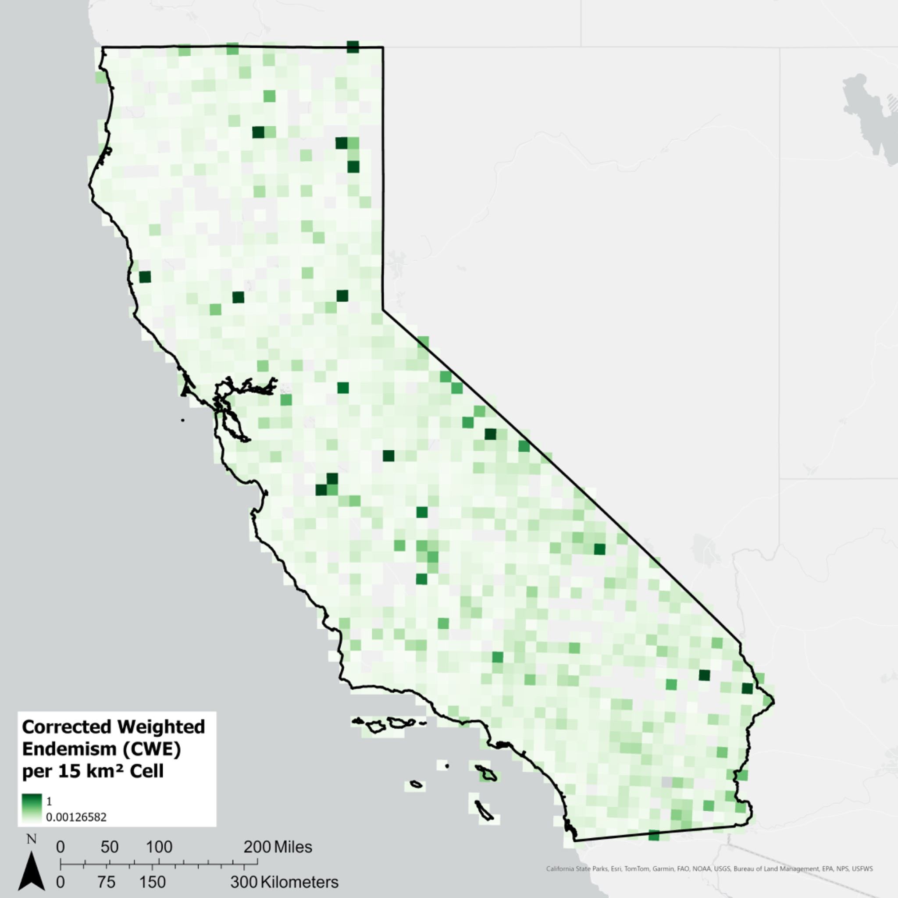
Corrected Weighted Endemism of Bee Species in California
Notes:
Here is a map of species richness of bee species across California

Slide 15
Average Precipitation Over 25 Years
Corrected Weighted Endemism of Bee Species in California

Slide 16
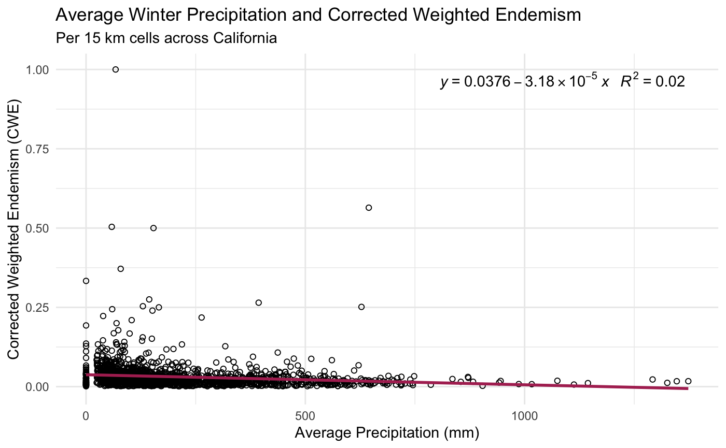
You can replace the image on the screen with your own work. Just delete this one and add yours

Slide 17
Code for Endemism and
Precipitation Graph
ggplot(data = beeData, aes(x = PPT, y = CWE)) +
geom_point(color = "black", pch = 21) +
geom_smooth(method = "lm", se = FALSE, color = "maroon") +
labs (
title = "Average Winter Precipitation and Corrected Weighted Endemism",
subtitle = "Per 15 km cells across California") +
xlab("Average Precipitation (mm)") +
ylab("Corrected Weighted Endemism (CWE)") +
theme_minimal() +
stat_poly_eq(aes(label = paste(..eq.label.., ..rr.label.., sep = "~~~")),
label.x = "right", label.y = "top", formula = y ~ x, parse = TRUE)
Notes:
Drier Areas are more important for bees and endemic species in California
Protection
Pay attention to the dry areas
Climate change and shifts in climate extremes may help with shift of bee distribution to increasingly arid areas
Extended periods of drought may put populations at risk
Range shifts
Management of lands reflect supporting bee populations

Slide 18
Corrected Weighted Endemism of Bee Species in California
Average Winter Precipitation Over 25 Years
Bee Species Richness Across California

Slide 19
Discussion
Drier Areas are more important for bees and endemic species in California
Protection
Climate Change
Range Shift
Land Management
How this will influence bees in drier environments
Conservation of drier lands for bees
Bees moving to new habitats

Slide 20
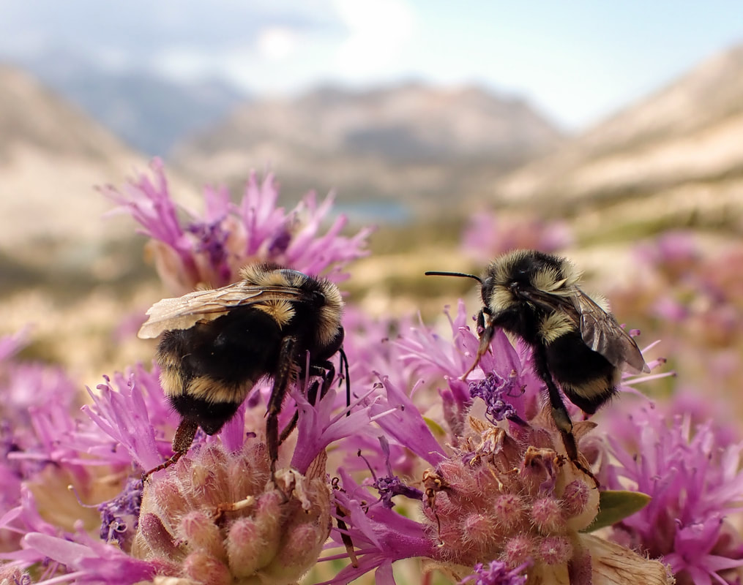
Next Steps
Learning more about bees in drier communities
Explore more climate variables
Notes:
This study points our focus to dry bee communities
Investigate bee communities in dryer areas
Next Steps
Explore more climate variables (Temperature, humidity, wind speed, etc.)
Explore the relationship between these climate variables

Slide 21



Acknowledgements
Dr. Gretchen LeBuhn
Denzill Loe
Gilbert Fabian Alarcon-Cruz
Chloe Martin
PINC Summer Program
Genentech

Slide 22
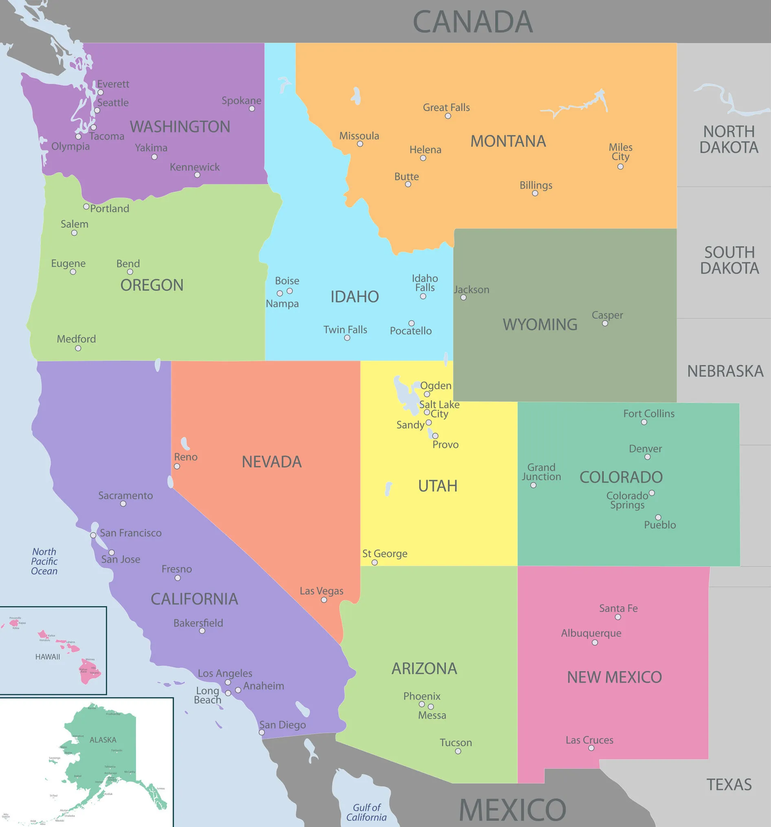
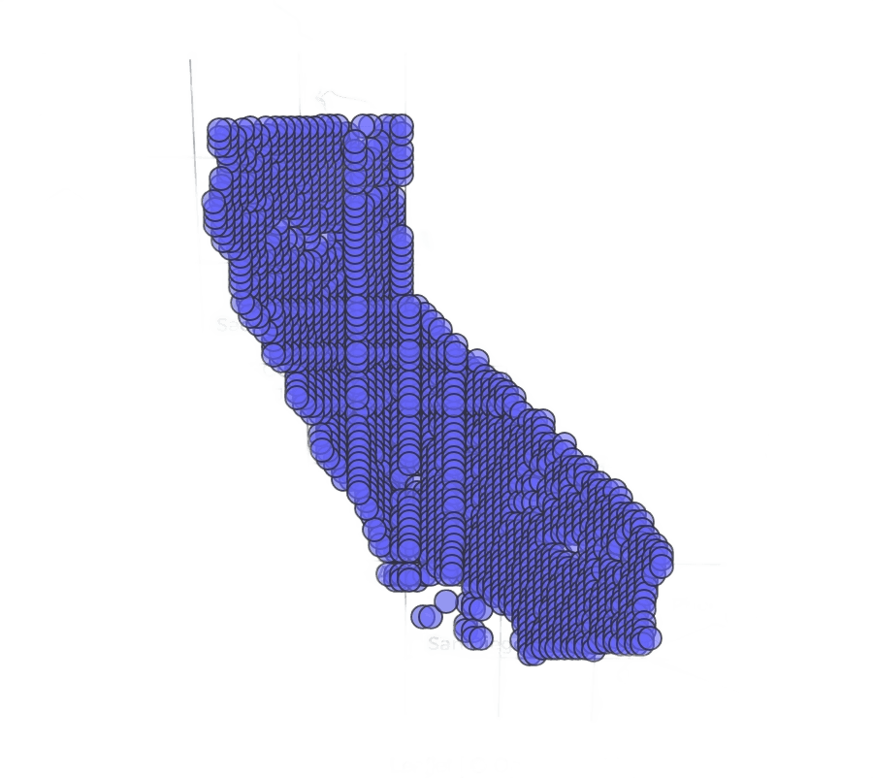
Species Richness Per Cell
probably not needed

